Slide 1
Finding a Suitable Location for Opening a New Restaurant in Neighborhoods of Toronto
Project by
G.R. Jeeva prashanna

Slide 2
Introduction
A restaurants success and failure depends on variety of factors. One of those many factors is its location.
The location a restaurant is as important as its quality and taste, besides location of a restaurant is a one-off factor.
it's important that we find a optimal location to run a restaurant.
AS A DATA SCIENTIST, WE ARE REQUIRED TO PROPERLY ANALYSE THE LOCATION OF VARIOUS NEIGHBORHOODS IN THE CITY AND FIND A PROPER LOCATION TO OPEN A RESTAURANT.
THIS PROBLEM IS MOSTLY FACED BY ALL THE ENTREPRENEURS THRIVING TO OPEN UP A BUSINESS. IN THIS PROJECT WE ARE GOING TO FOCUS ON THE RESTAURANT LOCATION.

Slide 3
Data sets to be used
Canada neighborhood data
Latitude and Longitude data for the corresponding neighbourhood
Venue Data

Slide 4
Description on dataset
the Canada neighborhood data is available in this Wikipedia page https://en.wikipedia.org/wiki/List_of_postal_codes_of_Canada:_M.
This dataset contains the Borough and corresponding neighborhood data.
The latitude and longitude dataset is already provided by the IBM team. This dataset contains all the latitude and longitude of all the neighborhoods.
we can match the neighborhood in both the dataFrame and create a new dataframe.
For the venue data, we will be using the foursquare API. I have already created a developer account in the website which gives us access to its venue data. This API will be used to extract all the restaurants in a particular neighborhood.

Slide 5
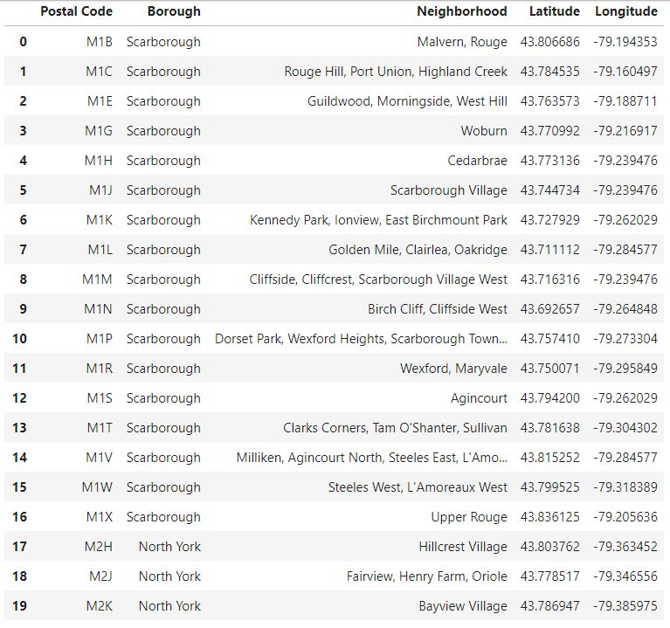
Canada dataset
This is the dataset after the scraping the Wikipedia page and adding the latitude and longitude data.

Slide 6
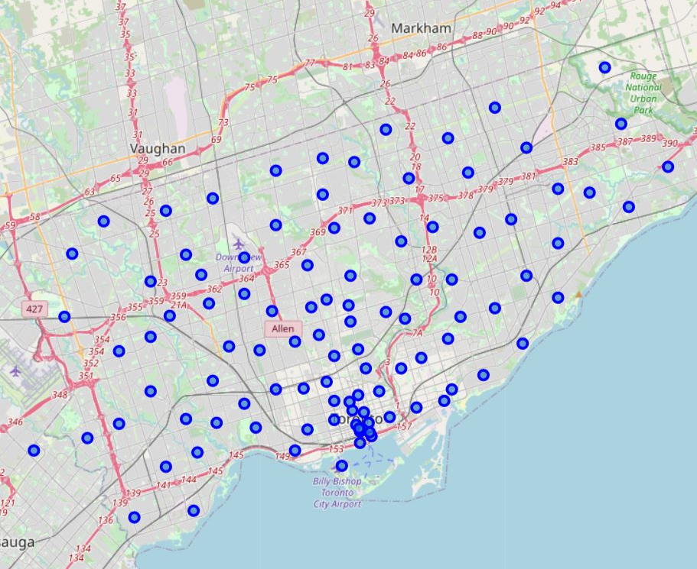
Methodology
Step1: Data cleaning and Visualization
In this step, I have imported all the required libraries and imported the dataset which was prepared in another notebook. So the code to prepare the dataset is not mentioned here. Further, in this step we will be visualizing the data using folium library.
MAP OF NEIGHBORHOOD IN CANADA

Slide 7
Step2: Fetching Indian restaurants in every neighbourhood
In this step we will be using Foursquare API to fetch all the Indian cuisine restaurants from each neighborhood.
It returns the value as a JSON file. So I have extracted only important elements from the JSON and is stored in “res_list”.
From this list a dataframe is created which contains elements like borough, Neighborhood name, latitude, longitude and restaurants name, latitude, longitude. we will be using the data frame for further clustering and analysis. This data frame is called as “new_df”.
After creating the database, we will be visualizing the restaurants BY USING folium map.
This is done to get a better idea on how close the restaurants are located to each other.

Slide 8
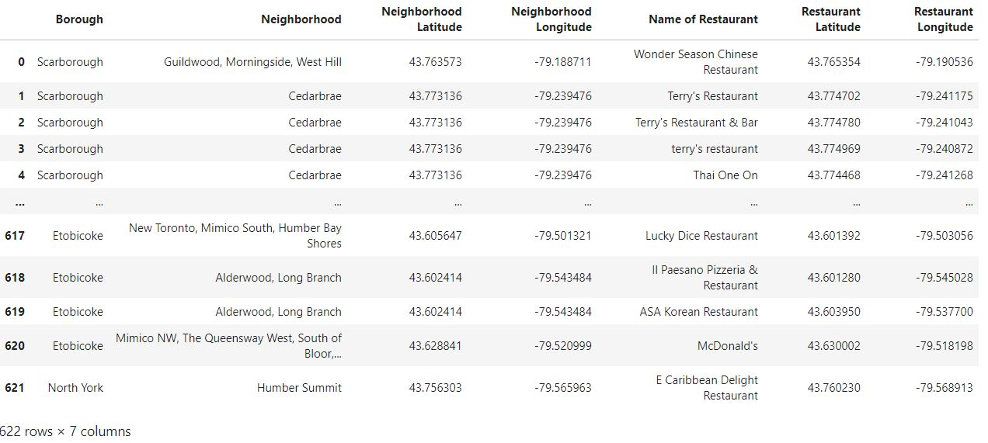
Final dataframe for clustering

Slide 9
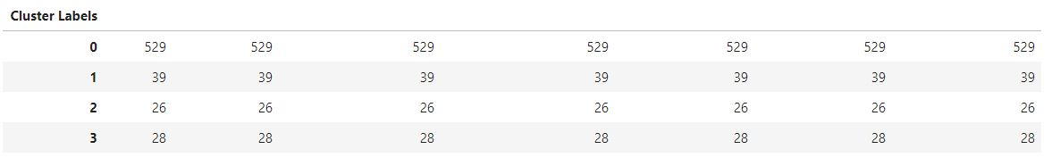
Step3: Clustering the Data
Clustering the restaurants using K-Means clustering. Clustering is done to help us find which part of Toronto has most no. of restaurants. We can use this insight to find where there will be more demand for a particular restaurant. The clustered data will be plotted by 4 different colours on Toronto map. The table below shows the number of restaurants in each cluster.

Slide 10
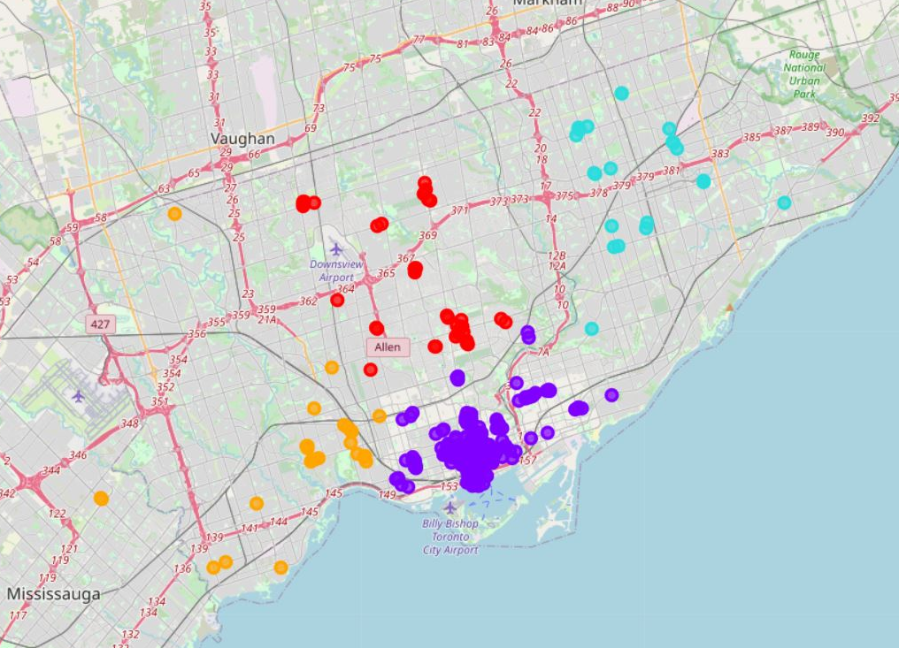
Visual representation of clustered data
.
.
Cluster 1 –
Cluster 2 –
Cluster 3 –
Cluster 4 –
.
.

Slide 11
Step4: Examine the Cluster
Examining the clusters. From each cluster we can find the most no. of restaurants in a particular neighborhood.
Step5: Grouping
Grouping by neighborhood and borough to find the no. of restaurants in each.

Slide 12
RESULT
1.1 Recommended location from cluster 2:
The below neighborhoods are recommended for restaurant,
Steeles West, L'Amoreaux West
Cedarbrae
1.2 Recommended location from cluster 3:
The below neighborhoods are recommended for restaurant,
Runnymede, Swansea
Parkdale, Roncesvalles
High Park, The Junction South
1.3 Recommended location from cluster 4:
The below neighborhoods are recommended for restaurant,
Davisville
Willowdale, Willowdale East

Slide 13
Conclusion and Future Scope
Purpose of this project was to find a good location to open an Indian restaurant. From research we found that an ideal place to open a restaurant is where there is average no. of competitors. Based on this assumption the entire project has been completed and recommended neighborhoods have been produced.
For further analysis, we can also include data like, Indian population, crime rate, labour wage etc.

